Slide 1
Object Oriented Programming
Week 1
Abeer GAUHER
Email: abeer.gauher@nu.edu.pk
Office: CS BASEMENT 2, Office number 17

Slide 2
Contents
Comparison from object oriented & procedural paradigms
Introduction to OO paradigm
Data Abstraction

Slide 3
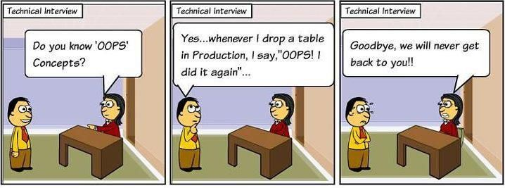

Slide 4
Programming Paradigms
Programming paradigms are a way to classify programming languages based on their features.
Common programming paradigm include:
imperative in which the programmer instructs the machine how to change its state,
procedural which groups instructions into procedures,
object-oriented which groups instructions with the part of the state they operate on.

Slide 5
Programming Paradigms
Procedural
For example,
Beginners All purpose Symbolic Instruction Code (BASIC) – it was developed to enable more people to write programs.
C – a general-purpose programming language, initially developed by Dennis Ritchie between 1969 and 1973 at AT&T Bell Labs.
Describe, step by step, exactly the procedure that should, according to the particular programmer at least, be followed to solve a specific problem.

Slide 6
Programming Paradigms
Object-oriented
Data and methods to manipulate it are kept as one unit called an object.
With perfect encapsulation, one of the distinguishing features of OOP, the only way that another object or user would be able to access the data is via the object's methods.
Thus, an object's inner workings may be changed without affecting any code that uses the object.

Slide 7
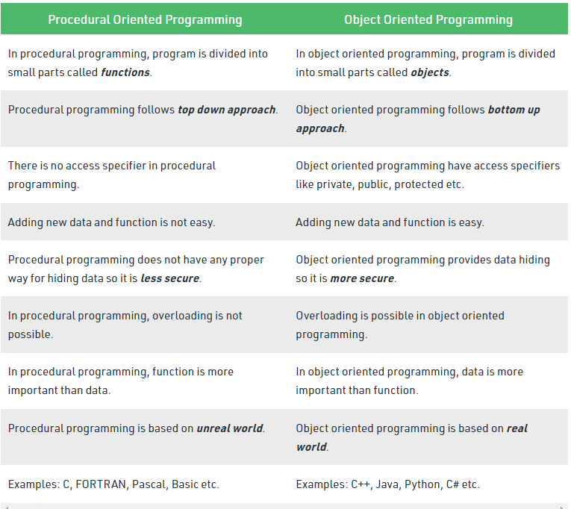

Slide 8
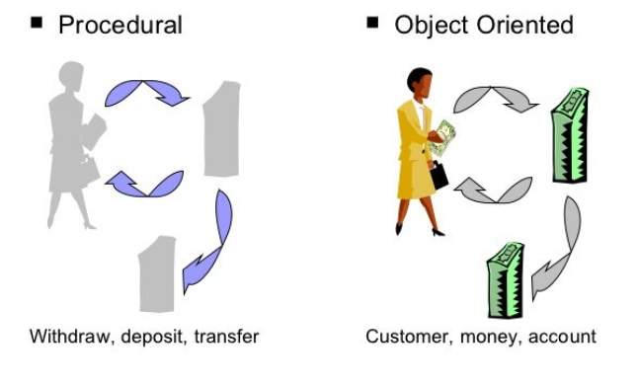
Procedural vs. Object-Oriented Programming

Slide 9
What is a Model?
A model is an abstraction of something
Real World Entities
Purpose is to understand the product before developing it

Slide 10
Examples – Model
Highway maps
Architectural models
Mechanical models

Slide 11
Example – OO Model

Slide 12
Example – OO Model
lives-in
Ali
House
Objects
Ali
House
Car
Tree
Interactions
Ali lives in the house
Ali drives the car
drives
Car
Tree

Slide 13
Object-Orientation - Advantages
People think in terms of objects
OO models map to reality
Therefore, OO models are
easy to develop
easy to understand

Slide 14
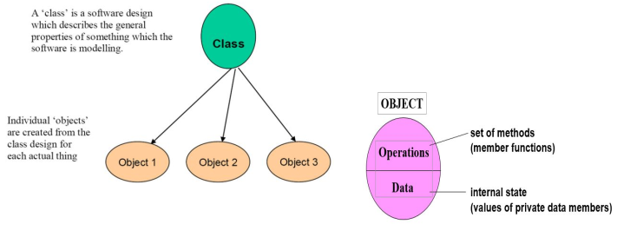
Class and Object

Slide 15
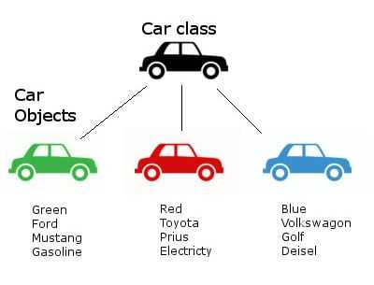
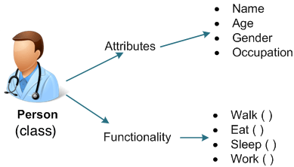
Class and Object

Slide 16
What is an Object?
An object is
Something tangible (Ali, Car)
Something that can be apprehended intellectually (Time, Date)
An object has
State (attributes)
Well-defined behaviour (operations)
Unique identity

Slide 17
Concept: An object has behaviors
An object contains both data and methods that manipulate that data
An object is active, not passive; it does things

Slide 18
Example – Ali is a Tangible Object
State (attributes)
Name
Age
behaviour (operations)
Walks
Eats

Slide 19
Example – Car is a Tangible Object
State (attributes)
- Color
- Model
behaviour (operations)
- Accelerate - Start Car
- Change Gear

Slide 20
Example – Date is an Object Apprehended Intellectually
State (attributes)
Year - Day
Month
behaviour (operations)
- Set Year - Set Day
- Set Month

Slide 21
Data Abstraction
Process of providing only the essential details to the outside world and hiding the internal details.
Let's take a real life example of AC, which can be turned ON or OFF, change the temperature, change the mode, and other external components such as fan, swing. But, we don't know the internal details of the AC, i.e., how it works internally. Thus, we can say that AC seperates the implementation details from the external interface.
C++ provides a great level of abstraction. For example, pow() function is used to calculate the power of a number without knowing the algorithm the function follows.

Slide 22
Data Abstraction
Data Abstraction can be achieved by:
Abstraction in header files
Abstraction in header files: An another type of abstraction is header file. For example, pow() function available is used to calculate the power of a number without actually knowing which algorithm function uses to calculate the power.

Slide 23
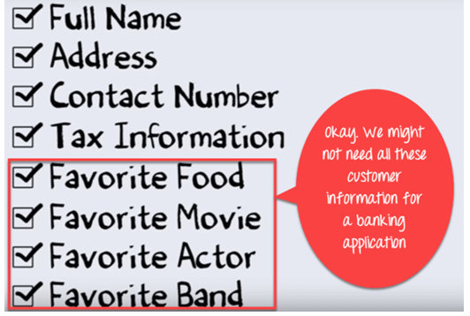
Data Abstraction
Let’s Study Abstraction in OOPs with example:
Suppose you want to create a banking application and you are asked to collect all the information about your customer.

Slide 24
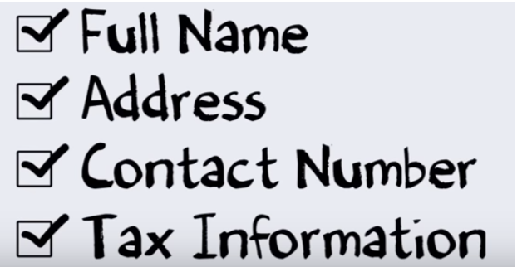
Data Abstraction
So, you need to select only the useful information for your banking application from that pool.
Data like name, address, tax information, etc. make sense for a banking application which is an Abstraction example in OOP.

Slide 25
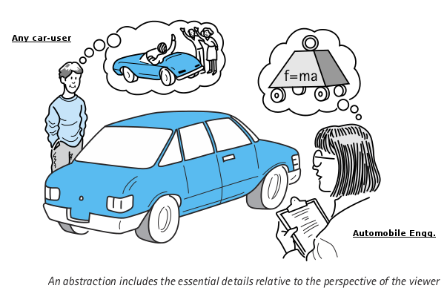
Data Abstraction

